Slide 1
Movie Ticket Booking System
Name: Nandan Bhowmick
Roll: 1436
Supervisor: Dr. Md. Shariful Islam

Slide 2
Table of Contents
1. Introduction
2. Motivation
3. Features
4. Challenges
5. Future Work

Slide 3
01
Introduction

Slide 4
What is it?
A system to book a movie ticket
Simpler version to demonstrate how the actual system works
Based on command-line interface and file handling

Slide 5
02
Motivation

Slide 6
Growing industry
Enhance user experience
Passion for movies

Slide 7
03
Features

Slide 8

Language Used:

Slide 9
The project includes:
Arrays
Vector
Structure
Map
String
Set
File handling

Slide 10
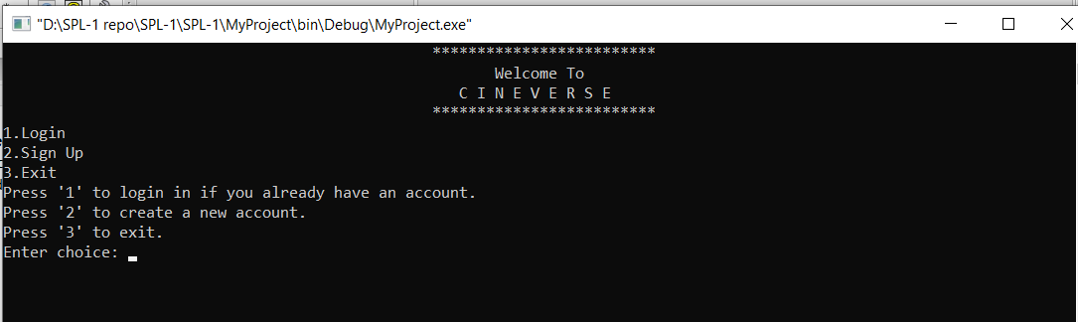
User Login/Sign up

Slide 11
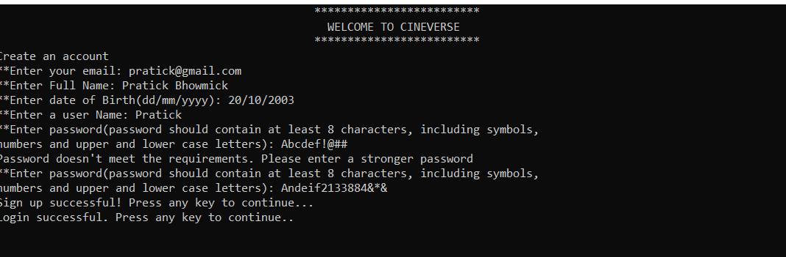
Sign up

Slide 12
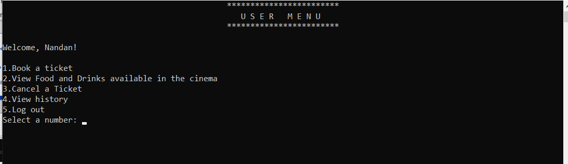
User Main Menu

Slide 13
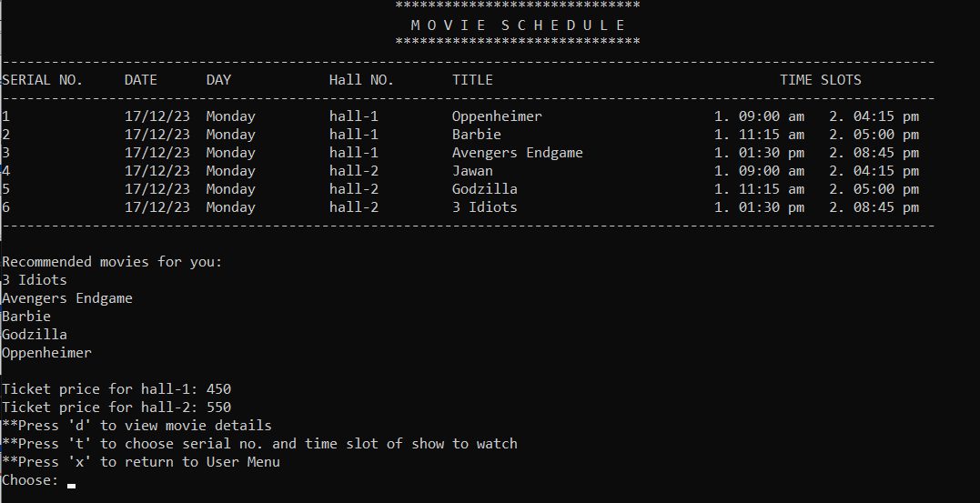
Booking Ticket

Slide 14
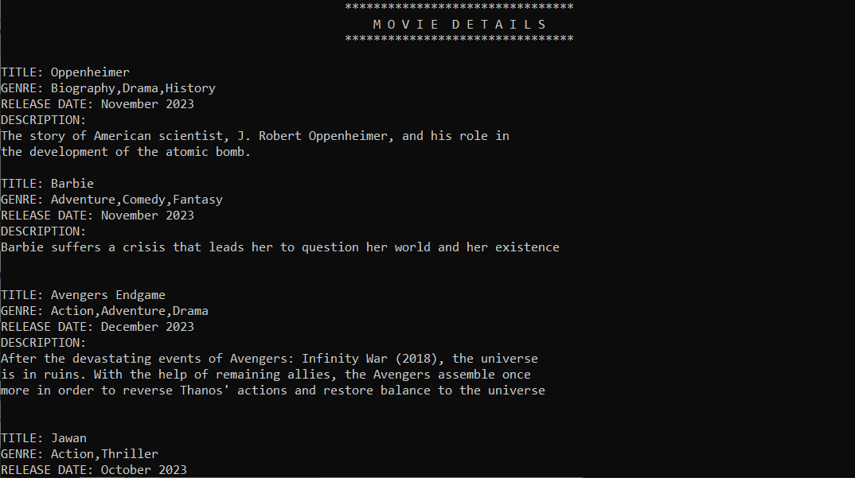
Movie details

Slide 15
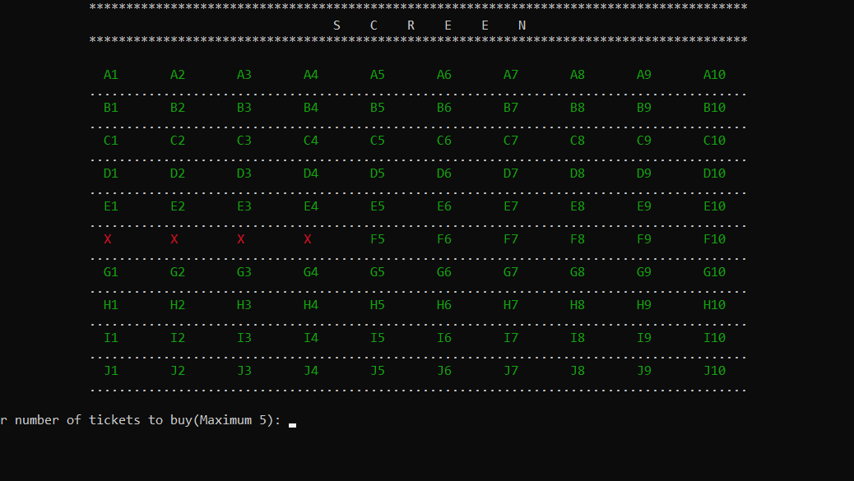
Booking Ticket

Slide 16
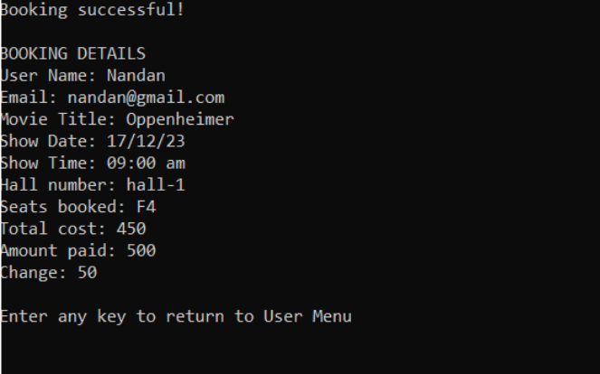
Booking Ticket

Slide 17
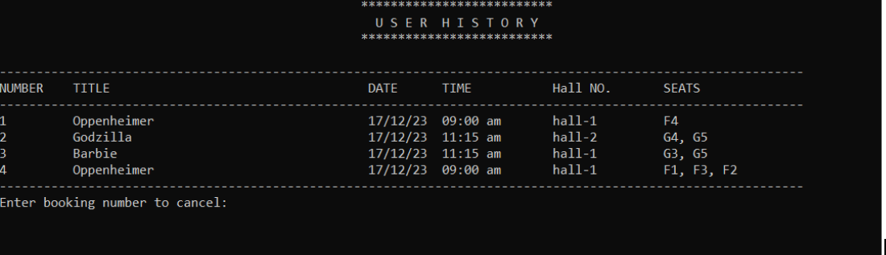
Booking cancellation

Slide 18
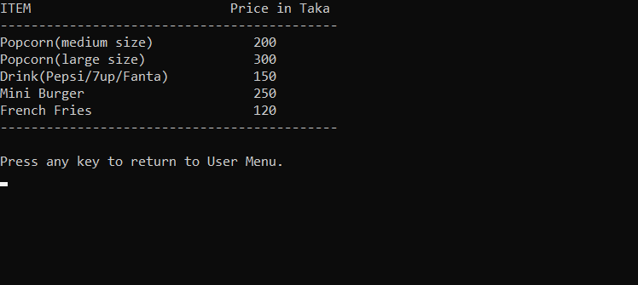
Food and drinks

Slide 19
04
Challenges

Slide 20
File Handling
Organizing information in files
Connection between different functions
Implementing booking and cancellation algorithm

Slide 21
05
Future Work

Slide 22
Increase number of shows
More error handling
Graphical User Interface(GUI)
Socket Programming

Slide 23
Thanks!

